Slide 1




REGISTERED OFFICE – VIA BRESSANI 4/B, 29017 FIORENZUOLA D’ARDA (PC), ITALY – PHONE: +39.0321/784127
HEADQUARTER – VIA G. FERRARIS 13, 43036 FIDENZA (PR), ITALY – PHONE: +39.0524/530259 – FAX: +39.0524/530142
info@trecoil.it
www.trecoil.it
Certified company ISO 9001:2008

Slide 2

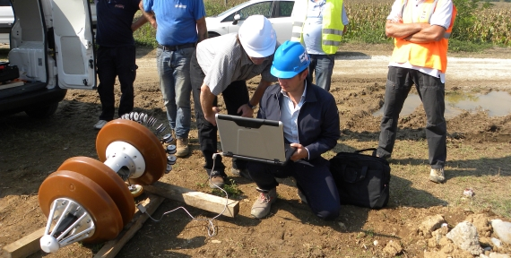
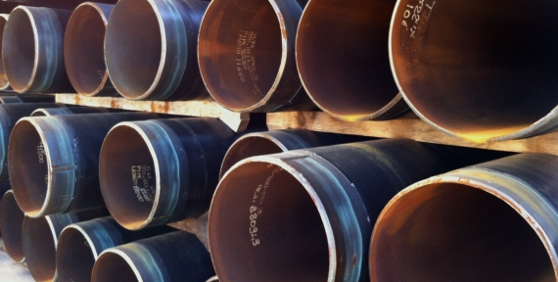
Company
Inspection
Projects
Clients
Certifications
Contacts
TRECOIL S.R.L.
INLINE INSPECTIONS OF
OIL & GAS PIPELINES
ENGINEERING SERVICES FOR
OIL & GAS COMPANIES
Trecoil S.r.l. carries out geometric inspections and testing pipeline at the main customers in the oil and gas market and quality, safety, environment and energy training activities.
Our team is a group of experienced and well trained professionals who know how to get things working. Although we are a young company in inspection area, most of us have long time experience in working with intelligent pipeline tools.
Execution of job coordination activities on behalf of engineering companies working for the oil, gas, petrochemical, water treatment and power industries.
In addition, the considerable and updated knowledge we have gained from our continuous contacts with the major manufacturers allows us to offer good support for any local procurement activity or market research to be carried out in Italy and in most of the European countries.
FROM 6" TO 56" PIPELINES
CALIPER PIGS SINGLE-CHANNEL AND MULTI-CHANNEL - MFL TOOL
PROJECT MANAGEMENT CONSULTING

Slide 3
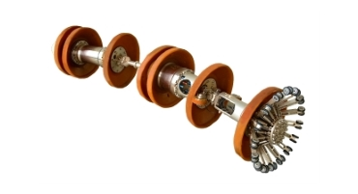
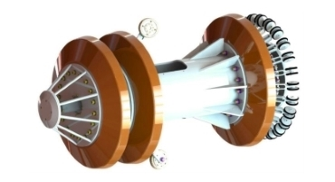
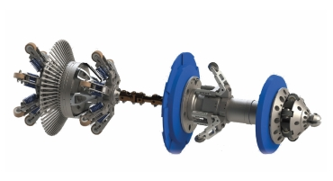

Company
Inspection
Projects
Clients
Certifications
Contacts
INSPECTION TOOLS
SINGLE-CHANNEL CALIPER PIG
Our Caliper Pig Single-Channel detects pipeline's diameter reductions and
variations such as dents, ovalities, circumferential welding and wall thickness variations, which reduce the internal diameter of the pipe.
MULTI-CHANNEL CALIPER PIG
The Multi-Channel Caliper Pig implements the ability of sizing and positioning the differentiation longitudinal and circumferential of the different types of defects.
MAGNETIC FLUX LEAKAGE
The MFL inspection activity detects metal losses, pitting (internal and external), and cracks. Also it provides inertial mapping (X, Y, Z) of the pipeline and measurement of the voltages induced by the movement of the ground.

Slide 4
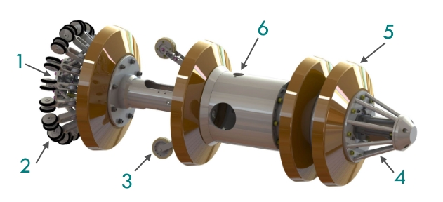
Company
Inspection
Projects
Clients
Certifications
Contacts
CALIPER PIG
PRINCIPLE OF OPERATION
The Caliper Pig measures diameter reductions in pipelines such as dents and ovalities.
Even diameter variations like girth-welds, wall thickness changings, T-pieces, valves and other installations are detected.
1.
Transmission disc
3.
Odometer wheel
5.
Drive cup
2.
Sensing fingers
4.
Locator unit
6.
Digital data recorder

Slide 5












Company
Inspection
Projects
Clients
Certifications
Contacts
CALIPER PIG
MEASUREMENTS
DENTS
OVALITIES
GIRTH-WELDS
WALL THICKNESS CHANGINGS
T-PIECES
VALVES
BENDS
OTHER INSTALLATIONS

Slide 6
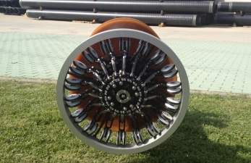

Company
Inspection
Projects
Clients
Certifications
Contacts
CALIPER PIG
FUNCTION
The Caliper Pig continuously measures the inside diameter of the pipeline through an array of sensing fingers ("spiders") that are spring loaded to hold them in contact with the pipe wall. A large number of sensing-fingers provide optimum coverage of the inside circumference. Wheels at the end of each sensing-finger are in direct contact with the pipe wall. The extremely flexible polyurethane cups enable the Caliper Pig to be transported through the pipeline by the medium. The Caliper Pig is able to pass reductions of at least 25%.
The spider is separate from the cup to eliminate effects from cup wear. As the Caliper Pig moves through the pipeline, all radial sensor movements are detected and recorded. ID-reductions of 0.4% will be detected.
Odometer wheels generate the distance data which in addition to the measuring data from the spider is continuously collected and stored together with the correlative diameter values.
To locate the Caliper Pig in the launcher, receiver or during survey, a locator unit is used. The locator unit transmits electromagnetic signals which will be detected by an external inspection tool locator. A pushing flange is used to push the Caliper Pig into the launcher and to protect the spider against mechanical damage.
The data-recorder contains all power, processing and recording circuits in a sealed module within the central body of the Caliper Pig.
CALIBRATION
Prior to the survey the Caliper Pig is calibrated by using a calibration ring and simulating dents and ovalities with small blocks of specified thickness. These calibration outcome is used to draw the calibration curve, which forms the basis to determine the diameter reduction which corresponds to the deflection on the chart.
The calibration will be done in 2.5 or 5 mm steps. Each survey chart shows a dent-calibration and a ovality-calibration at its beginning.

Slide 7
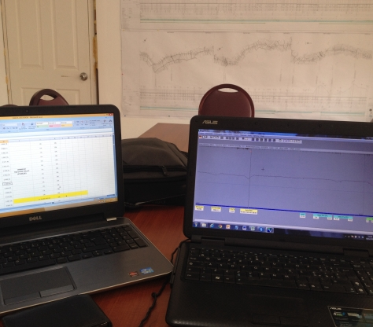
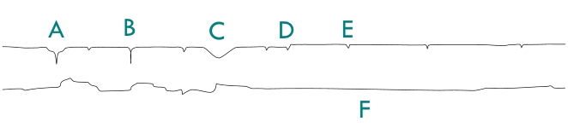
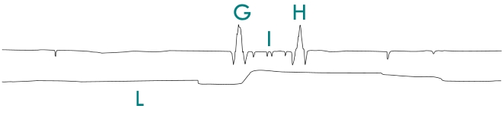
Company
Inspection
Projects
Clients
Certifications
Contacts
CALIPER PIG
DATA ANALYSIS AND INTERPRETATION
ANALYSIS
During the survey the Caliper Pig data are gathered in the solid state memory inside the recorder. After the run a laptop computer is connected to the Caliper Pig to download the data. The visualization of the survey chart is done on the laptop itself. The interpretation of the complete survey data will be done directly on screen. All interesting details are marked in the chart and a printout is added to the report.
INTERPRETATION
Before interpretation begins a minimum acceptable diameter reduction is agreed with the customer. The interpreter scans the chart for deflections which exceed the agreed value and compiles a features list. All indications exceeding the agreed value and also pipeline features like valves, T-pieces, wall thickness changes, girth-welds, bends and other installations are listed.
The following examples show typical pipeline features:
A – Ovality with dent | B – Dent | C – Ovality
D – Wall thickness change | E – Girth-weld | F – Speed
G – T-piece | H – T-piece | I – Valve
L – Speed

Slide 8
Company
Inspection
Projects
Clients
Certifications
Contacts
CALIPER PIG
FINAL REPORT
The Data Analysis Department consists of experienced people who work close together with the customer and service technicians.
The Final Report generally contains the data listed in the table.
The General Information provides details like names of the pipeline owner, the surveyd pipeline and the names of representatives and technicians.
Technical Data shows all important data concerning the pipeline the Caliper Pig and the survey run.
Details of how the job was carried out, principles of dates of the survey and progress of the job are given under Survey Procedures.
The Results are summarized in the features list. It contains several columns with all the important notes of the run.
Supplementary to the features list the calibration curves and the entire Printout of the chart is provided.
1.
General informations
2.
Technical data
3.
Survey procedures
4.
Results
5.
Features list
6.
Calibration curves
7.
Printout of the chart

Slide 9




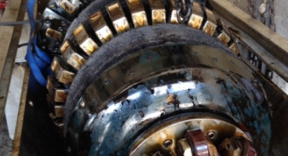
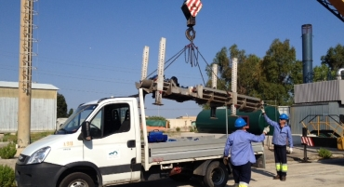
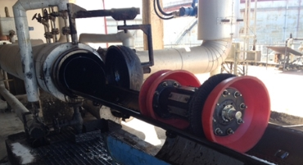
Company
Inspection
Projects
Clients
Certifications
Contacts
PIPELINE DN 400 (16") CENTRALE "FEDERICO II" BRINDISI NORD-BRINDISI SUD
(LENGTH: 11500 METERS)
CLIENT
CONTRACTOR
LOCATION
TIME
Enel Produzione S.p.A.
Enel Produzione S.p.A.
Italy
August 2015

Slide 10
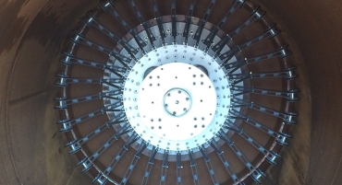
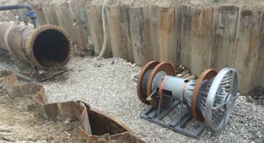
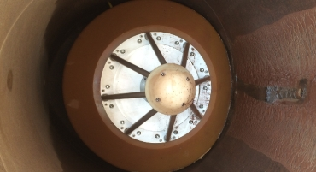
Company
Inspection
Projects
Clients
Certifications
Contacts
PIPELINE DN 1400 (56") ZIMELLA-CERVIGNANO, DP 75 BAR
STEP 1
CLIENT
CONTRACTOR
LOCATION
TIME
S.A.L.P. S.p.A. - I.CO.P. S.p.A.
SNAM Rete Gas S.p.A.
Italy
May 2015

Slide 11
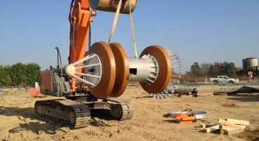
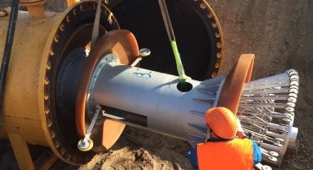
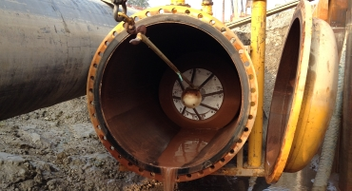
Company
Inspection
Projects
Clients
Certifications
Contacts
GAS PIPELINE DN 1400 (56") ZIMELLA-CERVIGNANO, DP 75 BAR
STEP 9, 10 & 11
CLIENT
CONTRACTOR
LOCATION
TIME
Bonatti S.p.A.
SNAM Rete Gas S.p.A.
Italy
October 2014

Slide 12
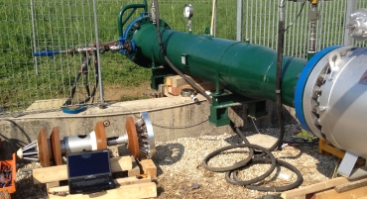
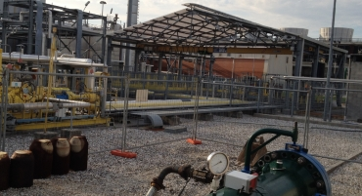
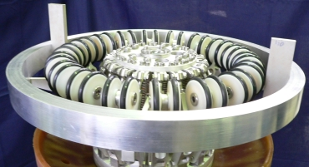
Company
Inspection
Projects
Clients
Certifications
Contacts
PIPELINE DN 400 (16")
FROM GONARS TO TORVISCOSA
CLIENT
CONTRACTOR
LOCATION
TIME
Edison Energia S.p.A.
---
Italy
August 2014

Slide 13
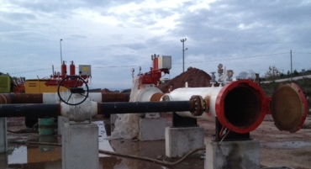
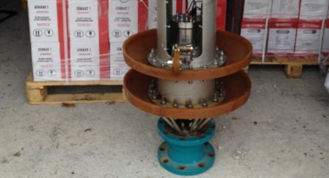
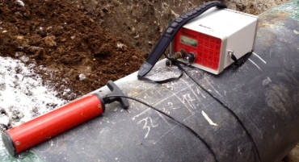
Company
Inspection
Projects
Clients
Certifications
Contacts
NATURAL GAS PIPELINE BOTAŞ CONSTRUCTION PROJECT
FROM SAKARYA TO KARASU
CLIENT
CONTRACTOR
LOCATION
TIME
Hitaş İnş. ve Tic. Ltd. Şti.
BOTAŞ - Petroleum Pipeline Corporation
Turkey
October-November 2013

Slide 14
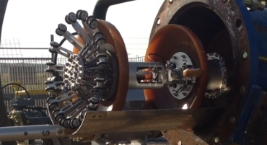
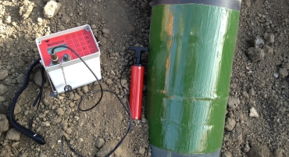
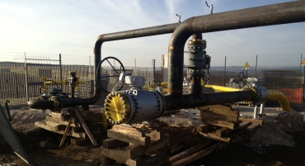
Company
Inspection
Projects
Clients
Certifications
Contacts
GAS PIPELINE DN 12" FROM LARINO TO CHIEUTI (LENGTH: 46357 METERS)
STEP 1 & 2
CLIENT
CONTRACTOR
LOCATION
TIME
Romana Costruzioni S.p.A.
SGI S.p.A.
Italy
November 2012

Slide 15














Company
Inspection
Projects
Clients
Certifications
Contacts
OUR MAIN CLIENTS
SICILSALDO S.P.A.
NUOVA GHIZZONI S.P.A.
CO.GE.CA. & C. S.P.A.
BONATTI S.P.A.
S.A.L.P. S.P.A.
SICIM S.P.A.
ROMANA COSTRUZIONI S.P.A.
S.I.C.CO. S.R.L.
HITAŞ İNŞ. VE TIC. LTD. ŞTI.
NACAP
EDISON S.P.A.
BOTAŞ - PETROLEUM PIPELINE CORPORATION
C.I.I. GUATELLI S.P.A.
TECHFEM S.P.A.

Slide 16
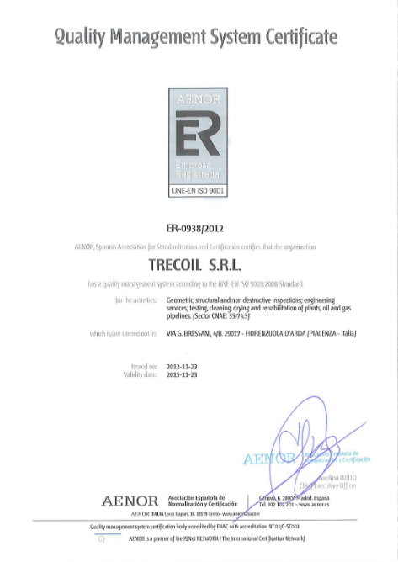
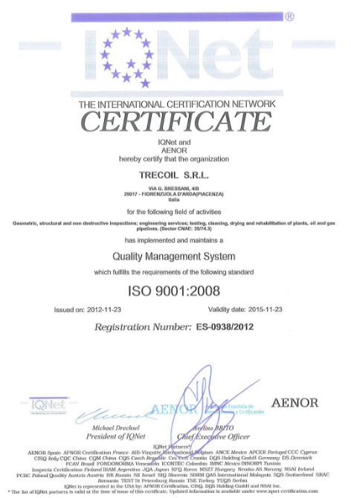
Company
Inspection
Projects
Clients
Certifications
Contacts
QUALITY ASSURANCE
QUALITY CERTIFICATION – ISO 9001
AENOR is a founder-member of IQNet, (International Certification Association), the largest international association of management systems certification bodies, whose international market share is estimated to be around 50%.
Along with its certificates and management systems marks, AENOR also issues the IQNet certificate, which provides organizations with a unique certificate that is widely recognized and respected in all international markets.

Slide 17
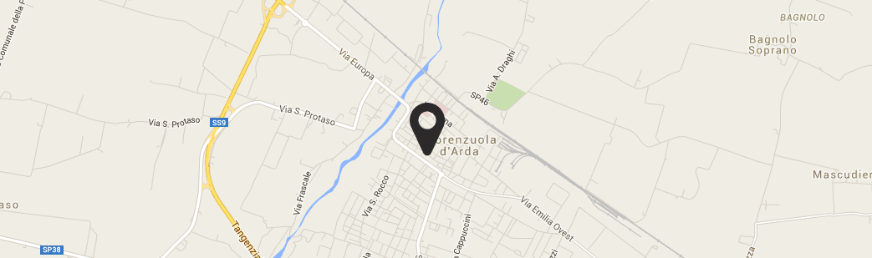



Company
Inspection
Projects
Clients
Certifications
Contacts
CONTACT INFO
ADMINISTRATIVE HEADQUARTERS
Via Galileo Ferraris 13, 43036 Fidenza (PR), Italy
+39.0524/530259 +39.0524/530142
REGISTERED OFFICE
VIA BRESSANI 4/B
29017 FIORENZUOLA D'ARDA (PC)
ITALY
INFO@TRECOIL.IT
+39.0321/784127

Slide 18
REGISTERED OFFICE – VIA BRESSANI 4/B, 29017 FIORENZUOLA D’ARDA (PC), ITALY – PHONE: +39.0321/784127
HEADQUARTER – VIA G. FERRARIS 13, 43036 FIDENZA (PR), ITALY – PHONE: +39.0524/530259 – FAX: +39.0524/530142
v1.4
info@trecoil.it
www.trecoil.it
Certified company ISO 9001:2008

